Slide 1
Future North America Priority Events Steve Preston IOTA Annual Meeting Oct 2015

Slide 2
Priority Events Full list posted at http://www.netstevepr.com/Asteroids/2016-NA-Best.html
Priority | Date | UT |  | Asteroid | Mag | Dur | Dia (km) | Rank
A | October 30, 2015 | 3:25 |  | (415) Palatia | 8.2 | 4.5 | 72 | 95
B | November 7, 2015 | 10:30 |  | (778) Theobalda | 10.5 | 9.1 | 66 | 95
A | November 11, 2015 | 4:45 |  | (29) Amphitrite | 9.1 | 24.3 | 207 | 100
A | January 22, 2016 | 5:53 |  | (115) Thyra | 9 | 7.3 | 81 | 99
B | January 24, 2016 | 3:30 |  | (866) Fatme | 9.5 | 6.8 | 87 | 99
Binary | January 27, 2016 | 3:40 |  | (283) Emma | 11.3 | 11.2 | 122 | 99
Binary | April 5, 2016 | 8:40 |  | (216) Kleopatra | 10.9 | 12 | 122 | 71
B | May 1, 2016 | 0:43 |  | (702) Alauda | 8.9 | 12.6 | 219 | 100
A | August 27, 2016 | 4:38 |  | (85) Io | 7.5 | 28 | 208 | 100
A | September 3, 2016 | 10:02 |  | (51) Nemausa | 7.6 | 31.8 | 166 | 100
B | September 8, 2016 | 4:15 |  | (224) Oceana | 6.9 | 4 | 54 | 97
B | September 14, 2016 | 3:11 |  | (372) Palma | 10.3 | 14.5 | 207 | 99
B | September 14, 2016 | 6:20 |  | (487) Venetia | 9.7 | 7.3 | 66 | 83
B | October 31, 2016 | 8:40 |  | (814) Tauris | 10.1 | 17.5 | 110 | 92

Slide 3
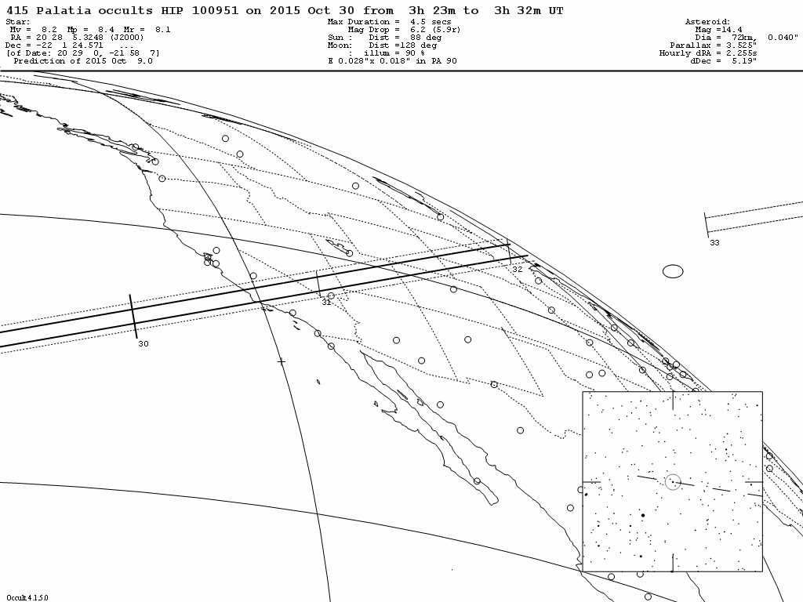
2015 Oct 30 (415) Palatia / HIP 100951 (m 8.2)

Slide 4
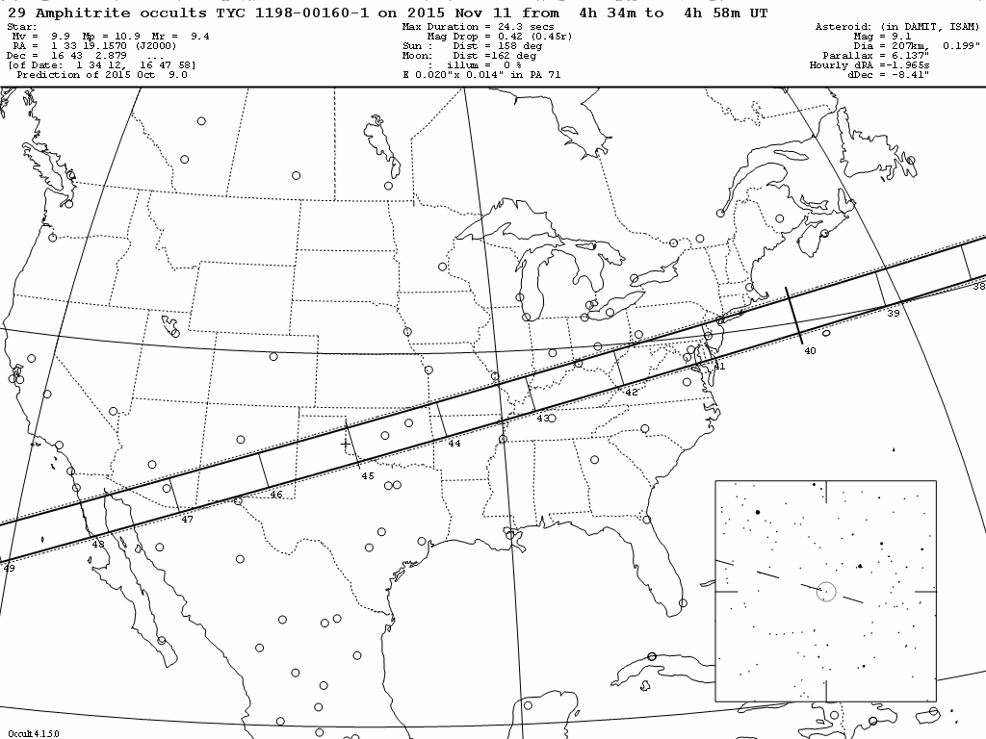
2015 Nov 11 (29) Amphitrite / TYC 1198-00160-1 (m 9.9)

Slide 5
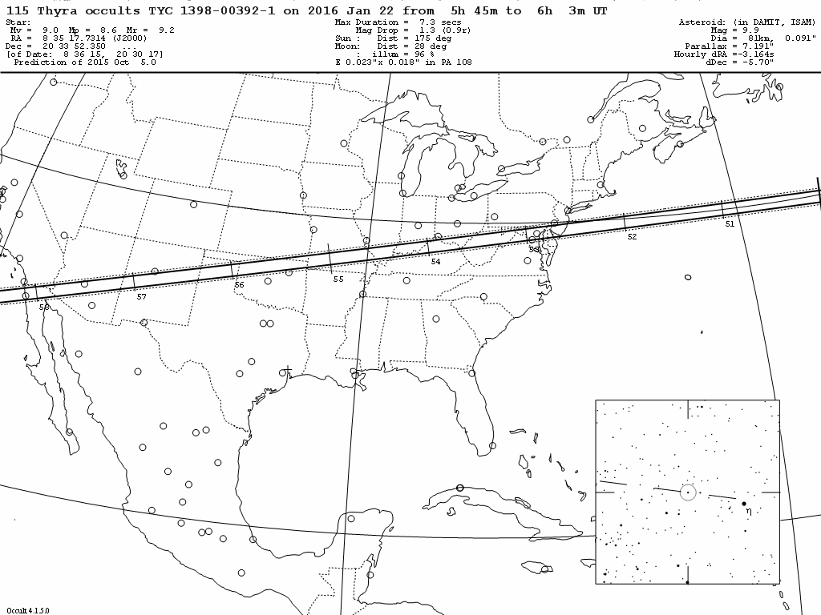
2016 Jan 22 (115) Thyra / TYC 1398-00392-1 (m 9.0)

Slide 6
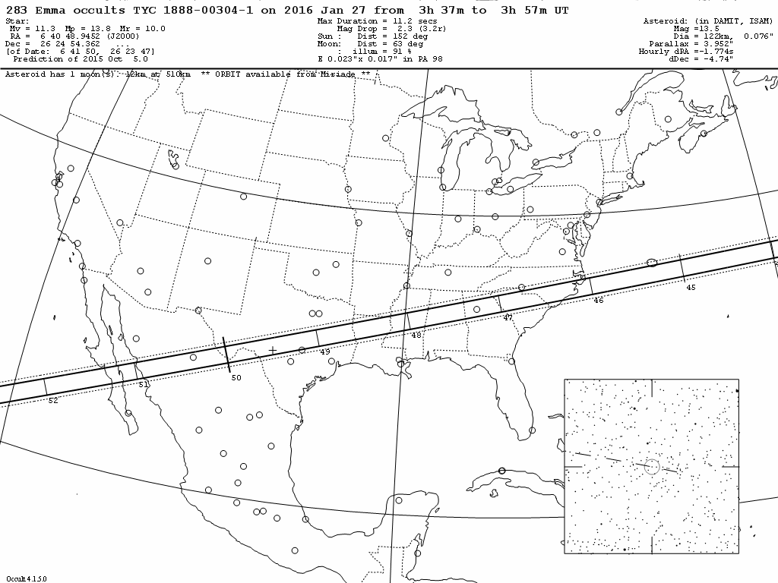
2016 Jan 27 (283) Emma / TYC 1888-00304-1 (m 11.3)

Slide 7
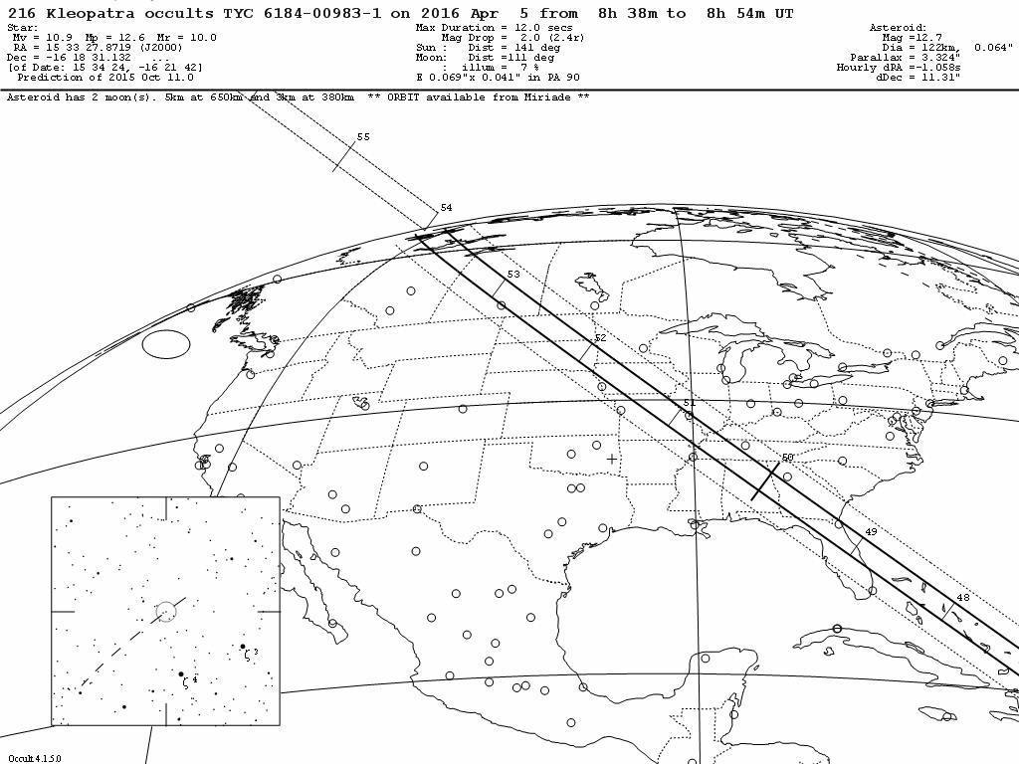
2016 Apr 5 (216) Kleopatra / TYC 6184-00983-1 (m 10.9)

Slide 8
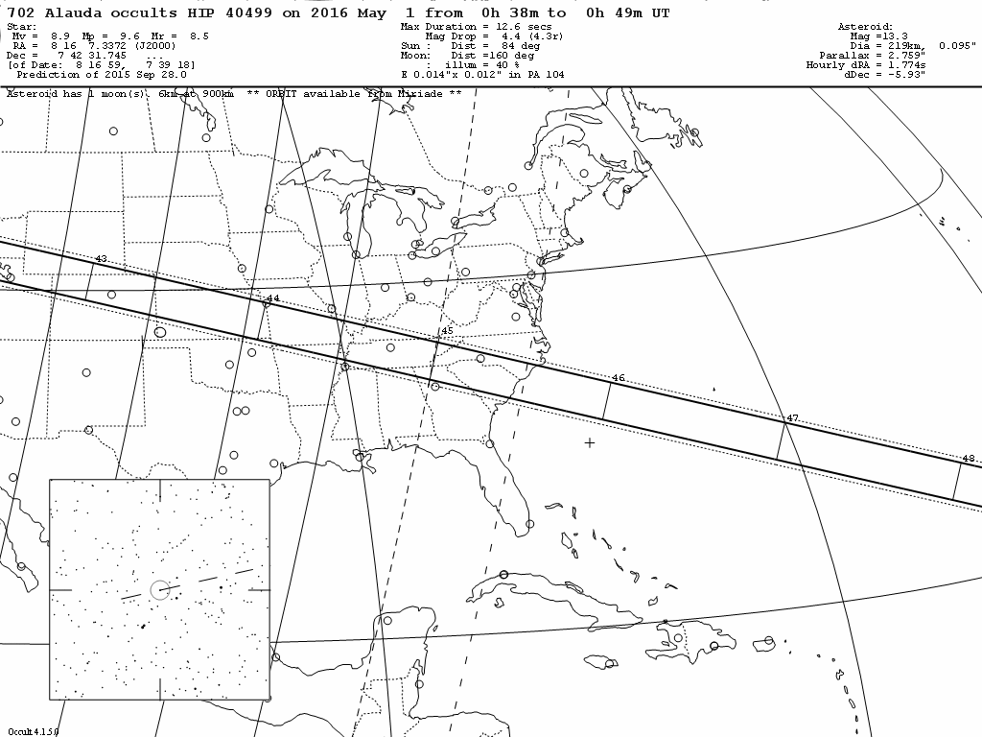
2016 May 1 (702) Alauda / HIP 40499 (m 8.9)

Slide 9
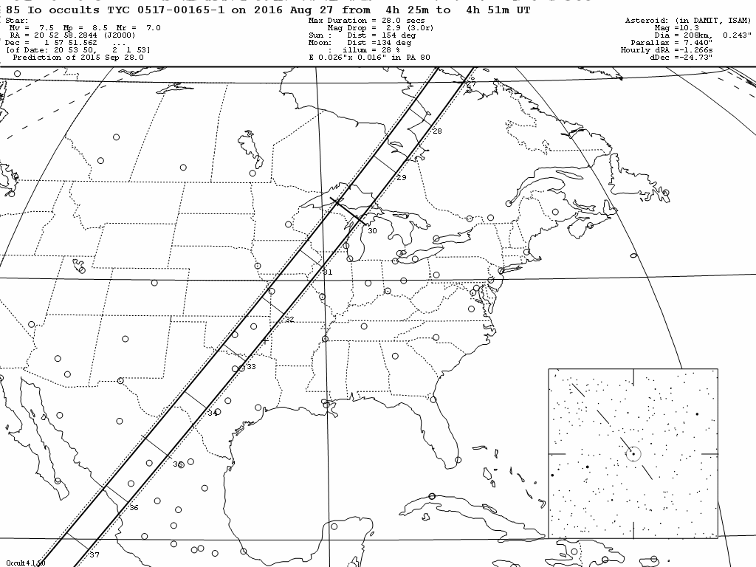
2016 Aug 27 (85) Io / TYC 0517-00165-1 (m 7.5)

Slide 10
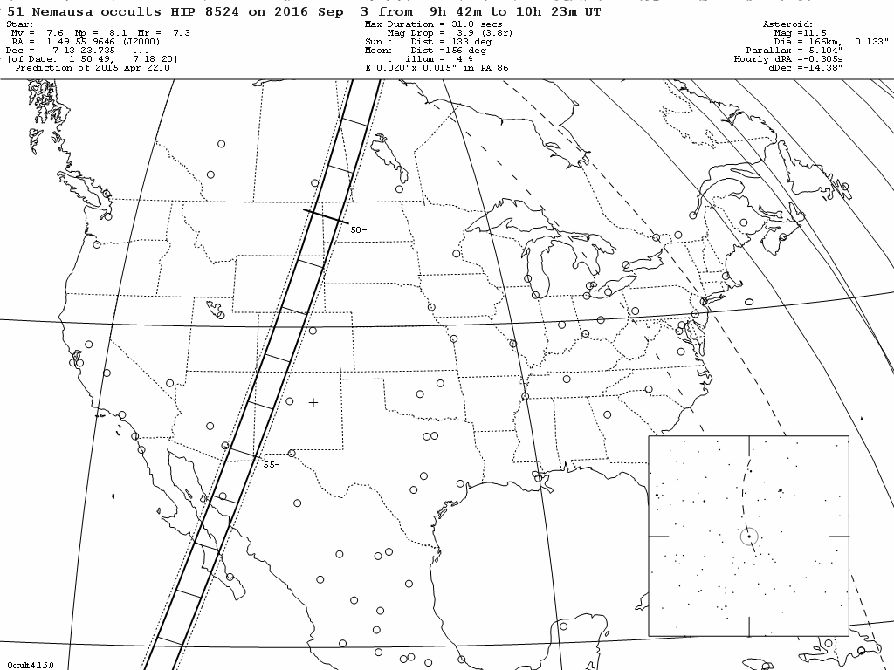
2016 Sep 3 (51) Nemausa / HIP 8524 (m 7.6)

Slide 11
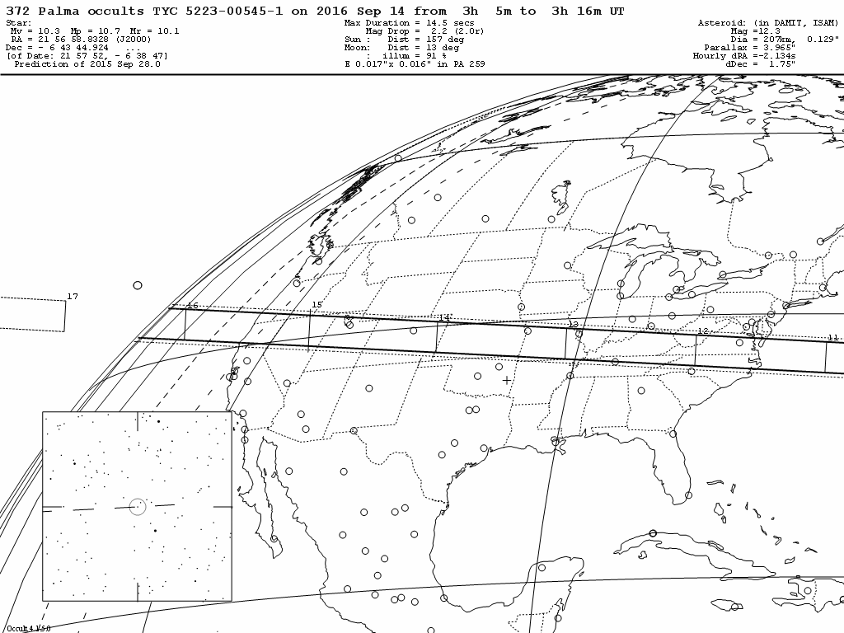
2016 Sep 14 (372) Palma / TYC 5223-00545-1 (m10.3)

Slide 12
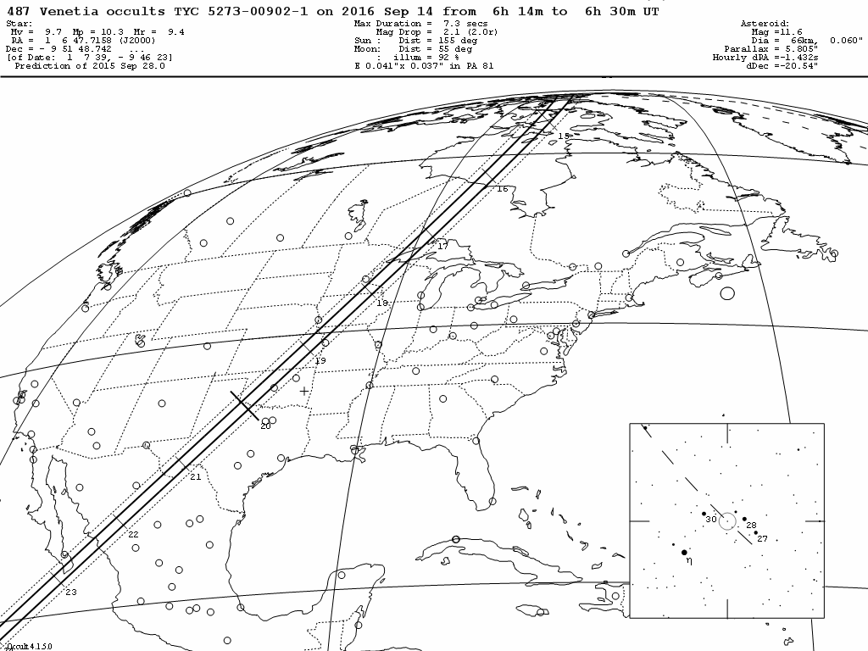
2016 Sep 14 (487) Venetia / TYC 5273-00902-1 (m 9.7)

